Slide 1
Module 2: Views and Charts in Requests
Analytics: Application Developer (Siebel 7.7)
Notes:
Time: Lecture: 30 – 40 minutes; labs: 30 – 45 minutes
Intent: To enable students to add and modify Siebel Answers UI elements for Analytics requests.
Flow: The module starts by looking at the types of views, how to modify views, and then looks at three types of views in particular: chart, pivot table, and column selector.
Key Terms:
View
Pivot table
Column selector
2

Slide 2

Module Objectives
After completing this module you will be able to:
  Add additional views of the data returned by the request
  Create and edit charts
Why you need to know:
  It is useful to be able to display data in many different ways
Notes:
Each objective and “why you need to know” should be stated aloud.

Slide 3
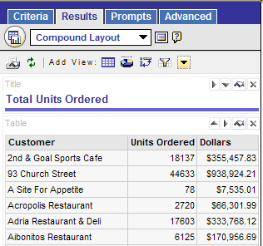
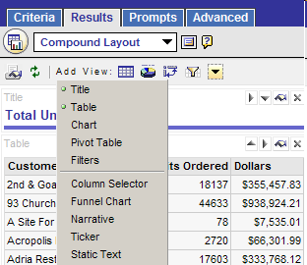
Siebel Analytics Views
The default view is the Compound Layout view, which includes Title and Table views
It is possible to display request results in multiple formats
Other views
Title view
Table view
Notes:
Views use the presentation capabilities of Siebel Analytics Web to help users look at results in meaningful, intuitive ways. You can add a variety of views to results, such as charts and pivot tables that allow drilling down to more detailed information, explanatory text, a list of filters that were used to limit the results, and more.
When you run a new request, Siebel Analytics displays results in a table, with a title preceding the table, by default. It does this by including a title view, which displays the name of the saved request, and a table view, which displays the results in a basic table. You can customize or delete these existing views for a request, add other views, and combine and position views anywhere in the workspace. Preparing multiple views of results can help you identify trends and relationships in data. If you are customizing results for display on a dashboard, you can preview how the combination and position of views will look when viewed on a dashboard.
2

Slide 4
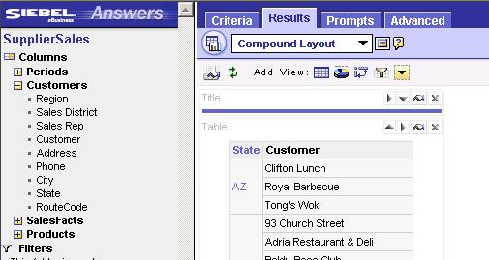
Working with Views
Select the Add View link or View drop-down list to select a view
Add a view to the request using the Add View buttons
Edit, move, or delete views as necessary
View drop-down
Add View buttons
Delete View
Edit View
Move View
Notes:
This slide identifies some of the common tasks performed when working with views. Callouts point to the icons used to perform these tasks.

Slide 5
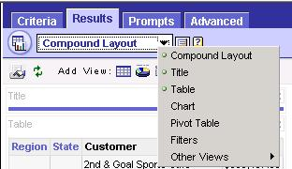
Totals
Can be calculated in a request with hierarchical results
Examples:
  Show sales volume by region, state, and city
  Request subtotals by region and state
Are created in the Results tab, Table view
Select Table from the View drop-down list to change view to add totals
Notes:
Totals can only be added in the Table view.
2

Slide 6
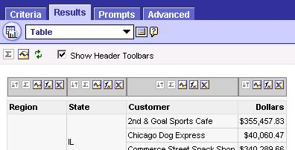
Totals Continued
To get subtotals at a midlevel, click the Break Total button on the column
To get a grand total for the request, click the Grand Total button
Grand Total button
Break Total button
Notes:
Break total values are calculated every time the value in the selected column changes.

Slide 7
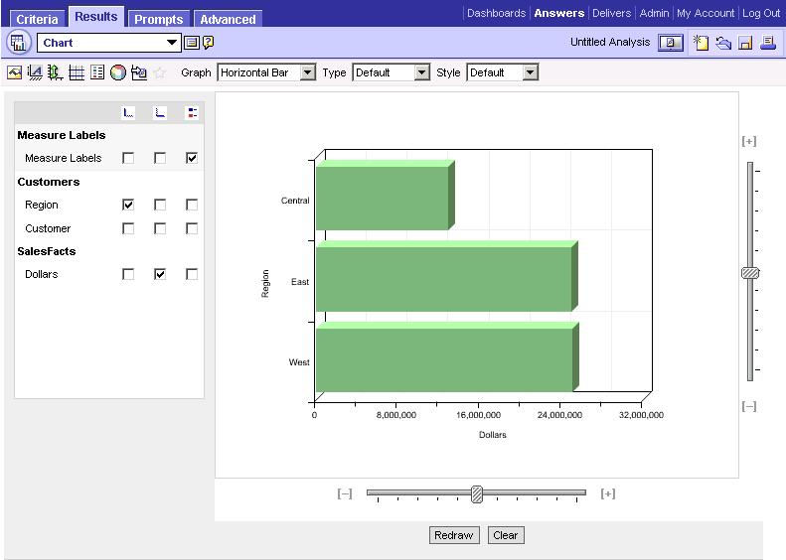
Chart UI
Chart options
The Chart view has its own UI
Chart columns
Scale chart size
Preview results
Notes:
This slide is a graphical structuring slide introducing the components of the chart view. Provide a brief overview, but do not teach the components here because the following slides cover them in detail.
2

Slide 8
Chart Options
Types of graphs:
  Area
  Horizontal bar
  Bubble
  Vertical bar
  Line
  Line bar combo
  Pareto
  Pie
  Radar
  Scatter
Notes:
Do not teach the details of each chart type here; this is simply a list of the possible chart types.

Slide 9
Chart Options Continued
Edit the defaults for the chart by selecting the appropriate button
General chart properties
Axis scaling
Chart legend
Interaction
Axis titles and legends
Chart border and colors
Gridlines
Notes:
This slide identifies some of the options for building and modifying charts. It is a good idea to demo some of these features:
General chart properties: Title, Data Labels, Size
Axis titles and legends: Separate Title and Label properties for Left and Bottom axes
Axis scaling: Axis Limits and Tick Marks & Scale Type
Gridlines: Two types of gridlines: major and minor; can set the color and visibility for each
Chart Legend: Determine where the Legend displays and can truncate the legend, if desired
Chart border and colors: Set the background, text, and border colors
Interaction: Can enable or disable drilldown (if present), or navigation to other requests
2

Slide 10
Chart Columns
Choose which columns in the request will be graphed
  Not all columns have to be graphed
Columns on the vertical axis
Columns on horizontal axis
Notes:
As you select or deselect columns, you will need to click the Redraw button at the bottom of the chart preview in order to see your changes.

Slide 11
Chart Scale
Change the size of the graph using the scale bars on the vertical and horizontal axis
Visibility of items may change depending on the scale setting
Slide to change, then click Redraw
Notes:
Siebel Analytics uses a third-party charting engine. The type of the chart, its size, and the number of elements charted can affect whether axes or legends are displayed. This is constrained by the amount of available space on the Web browser page. Sometimes, by adjusting the width and height controls, it is possible to get un-displayed axes and legend values to appear.
2

Slide 12
Pivot Tables
Allow the row, column, and section headings to be rotated in order to obtain different perspectives of the same data
Are interactive
  Drillable
  Navigable
Are a type of view
  Default setting is to return a table
  Can add a graph of the results
Notes:
A pivot table allows you to take row, column, and section headings and swap them around to obtain different perspectives. You can drag and drop headings to pivot results, preview them, and apply the settings. Users can navigate through pivot tables and drill down into information. Users can create complex pivot tables that show aggregate and non-related totals next to the pivoted data, allowing for flexible analysis.

Slide 13
Process for Creating a Pivot Table
0/5
Create a request in the Criteria tab
Click the Results tab and select Pivot Table view
Rearrange elements as necessary
Add a graph if desired
Go back to Compound view and remove other views
Notes:
This is a structuring slide. Do not teach the steps or concepts here because the following slides cover them in detail.
2

Slide 14

1. Create a Request in the Criteria Tab
1/5
Create a request using columns from a subject area just like any other request
Notes:
This is a screen shot of the Criteria (columns) that will be used to create the pivot table.

Slide 15
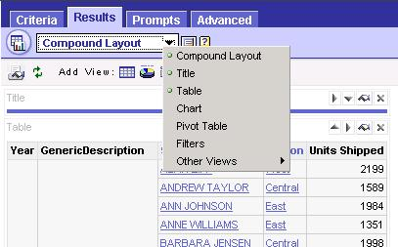
2. Click Results Tab and Select Pivot Table View
2/5
The Pivot Table view is accessed from the View drop-down list
Select the Pivot Table view
Notes:
2

Slide 16
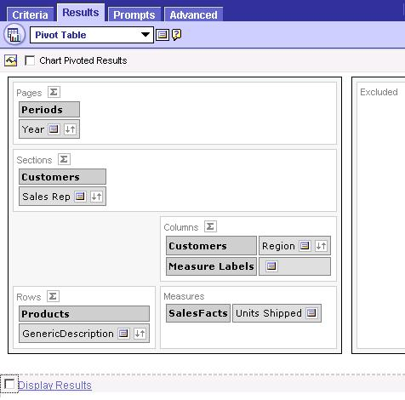
3. Rearrange Elements as Necessary
3/5
The columns included in the request appear as elements in the pivot table template
Drag and drop elements
To avoid delays, deselect until done rearranging
Notes:
Emphasize the performance issue with the Display Results option.
Note that the Break Totals buttons have more options in the Pivot Table View, including controlling where the total row appears and overriding the label.
Also note that You can dynamically convert a stored or calculated measure on a pivot table into a percent or an index. This shows the relative value of the item, compared to the total, without the need to explicitly create a calculation for it.
For example, if you are using a pivot table to examine sales by region, you can duplicate the sales measure and view it as a percentage of the total. This allows you to see the actual sales, and the percentage of sales, that each region accounts for.
To use this feature:
1. Click the More Options button for the item you want to show as a relative value.
2. To duplicate the measure, select the Duplicate Layer option.
The measure is displayed a second time in the pivot table, with the same name. If you want to rename the measure, click More Options and select Rename.
Note: This step is optional. When you duplicate the measure in the pivot table, you can see both the total for the measure and its relative value. This eliminates having to add the column twice on the Criteria tab to see the total and its relative value in the pivot table.
3. Select the option Show Data As and choose Percent of or Index of, and then the appropriate submenu option, if appropriate.

Slide 17
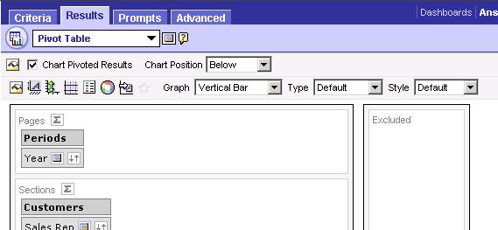
4. Add a Graph if Desired
3/5
Chart controls are the same as in the Chart view
Select to add a chart
Chart controls
Notes:
The graph will be based on the pivot table results, not the table results (as the Chart view does).
2

Slide 18
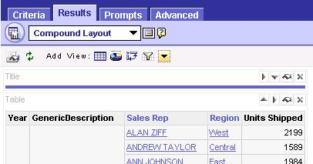
5. Go Back to Compound View and Remove Other Views
5/5
Usually, there is no need for both the Table and Pivot Table views
Delete Table View
Notes:
This is also based on performance as well as presentation criteria.

Slide 19


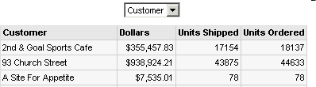
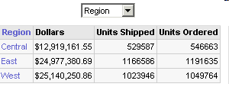
Column Selector
Allows users to dynamically change results based on the selected column
Select column
Results change dynamically based on column selection
Notes:
Use the Column Selector view to permit users to dynamically change which columns appear in results. This allows users to analyze data along several dimensions. By changing the facts, users can dynamically alter the content of the results.
2

Slide 20
Creating a Column Selector View
0/5
Create request
Click Results and select Column Selector view
Select the Include Selector option
Add column choices
Verify results
Notes:
This is a structuring slide. Do not teach the steps or concepts here because the following slides cover them in detail.

Slide 21

1. Create Request
1/5
Create a request using columns from a subject area just like any other request
Notes:
In Siebel Answers, create or modify the request with which you want to work.
2

Slide 22
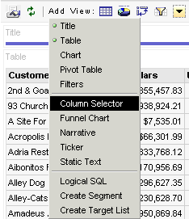
2. Click Results and Select Column Selector View
2/5
Click Add View in the Results tab to select the Column Selector view
Click Add View
Select Column Selector
Notes:
To add a new column selector view, click the Results tab and choose Other Views > Column Selector from the views drop-down list. To edit an existing Column Selector view, click the Results tab, choose Compound Layout from the views drop-down list, and then click the Edit View button for the column selector view.

Slide 23
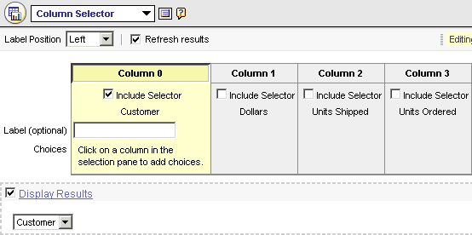
3. Select the Include Selector Option
3/5
Select the Include Selector option for each column in which you want a column selector to appear
Select Include Selector
Add label if desired
If checked, results display automatically
Notes:
Select the Include Selector option for each column that you want a column selector to appear. Type a label for each selector and select a position for the label. If you do not type a label, users viewing the results will not see a label on the selector.
2

Slide 24
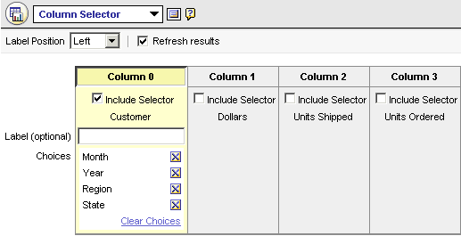
4. Add Column Choices
4/5
From the subject area in the selection pane, select the columns you want in the selector
Add columns
Use Clear Choices or delete buttons to remove choices
Notes:
From the subject area in the selection pane, select the columns you want in the selector. If you want to remove a specific choice from a column selector, click the Delete button. To remove all choices, click the Clear Choices link.

Slide 25
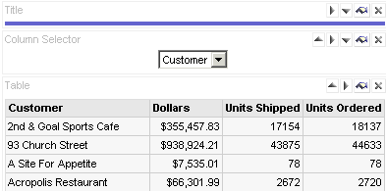
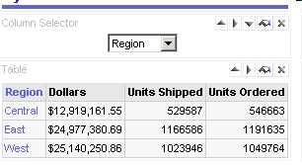
5. Verify Results
5/5
Save the request with the Column Selector view and verify results
Column selector set to Customer
Column selector set to Region
Notes:
When you are done, you can save the request with the column selector view and verify results.
2

Slide 26
Summary
This module showed you how to:
  Add additional views of the data returned by the request
  Create and edit charts
Notes:
Review Questions:
Question: Where do you add break totals to a request?
Answer: Results tab, Edit view
Question: True or false? A pivot table is the default view for the results of Siebel Answers requests.
Answer: False; a compound layout view is the default.
Question: What is the purpose of a Column Selector view?
Answer: Column Selector views permit users to dynamically change which columns appear in results.

Slide 27
Lab
In the lab you will:
  Modify views
  Create a pivot table
  Create a column selector
Notes:
Labs and Troubleshooting:
See Lab Guide for details.
Students may run into performance issues in the Pivot Table lab. Make sure they have de-selected Display Results while working with pivot tables.
2

